Slide 1
URBAN SANITARY MAINTENANCE
UNDER THE GUIDANCE OF
MRS M.SWAPNA REDDY
BY
BATCH - A8
1608-18-733-301 – M.SUSHEEL
1608-18-733-302 – U.RAKESH
1608-18-733-037 – S.YADAGIRI

Slide 2
Abstract
Usually now-a-days online platforms are playing crucial role in contributing to various fields like medical appointments, online ticket reservations, hotel bookings, e-shopping, online fee payments etc.
Here this particular project’s main objective is to develop an online complaint and maintenance system for urban level sanitary works by the citizen complaints and to take them to higher authorities eye, so the work will be done accordingly.

Slide 3
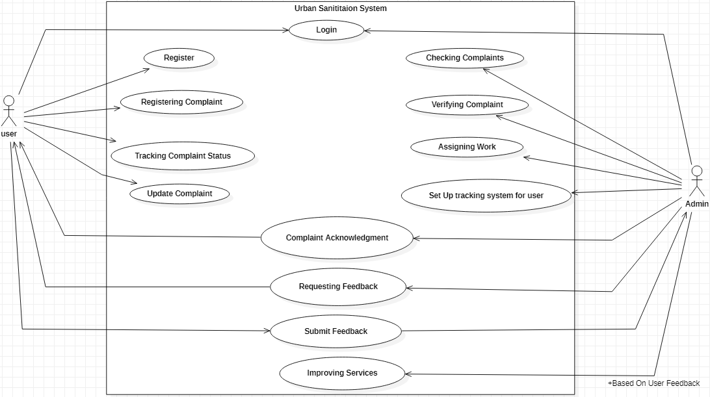
System Design
Use Case Diagram

Slide 4
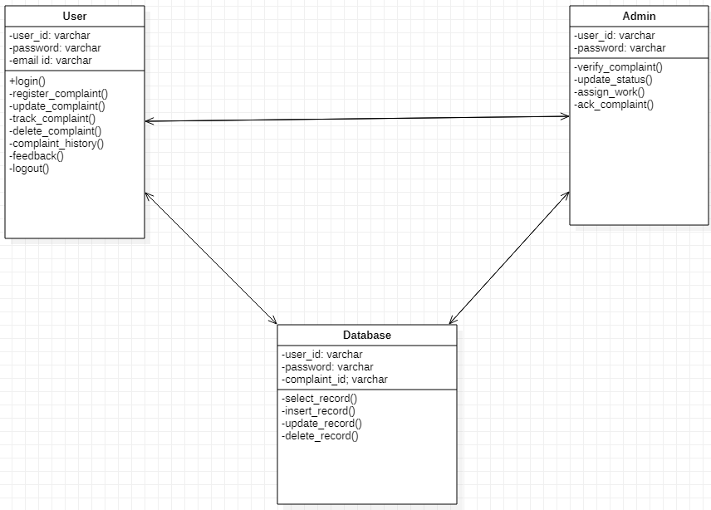
System Design
Class Diagram

Slide 5
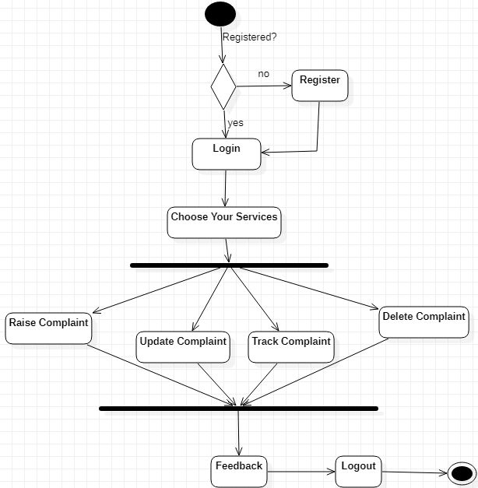
System Design
Activity Diagram

Slide 6
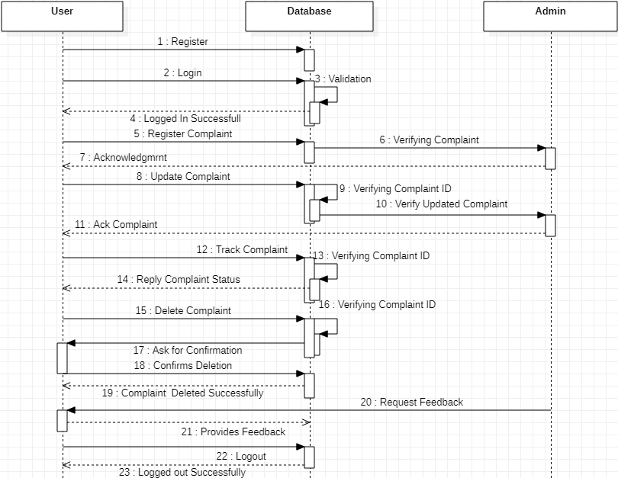
System Design
Sequence Diagram

Slide 7
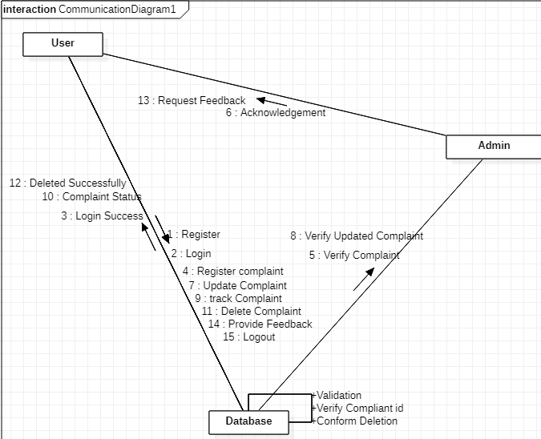
System Design
Communication Diagram

Slide 8
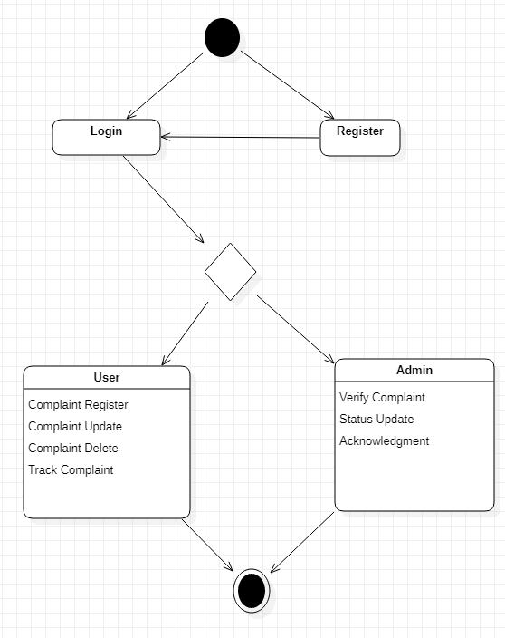
System Design
State Chart Diagram

Slide 9
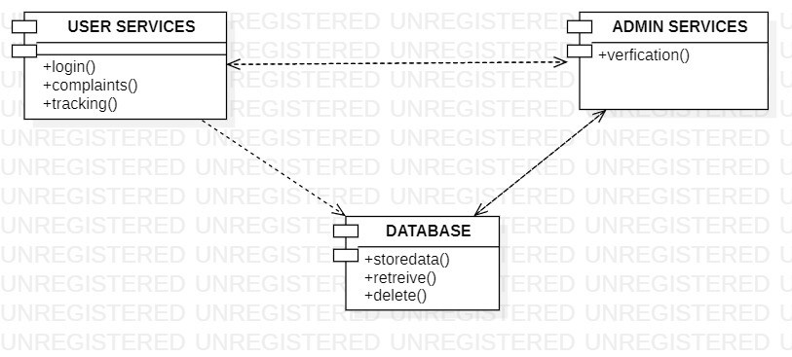
System Design
Component Diagram

Slide 10
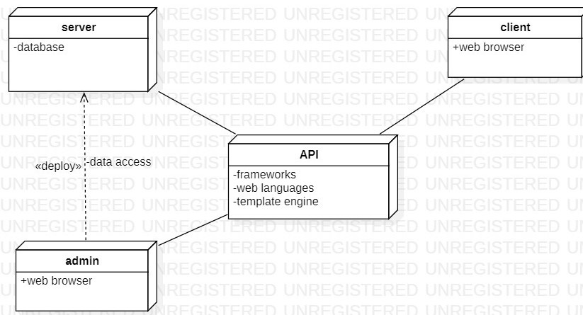
System Design
Deployment Diagram

Slide 11
Technology Stack
Microsoft Visual Studio Code
MySql server
Node.js
HTML, CSS,javascript
Handlebars (.hbs) template engine

Slide 12
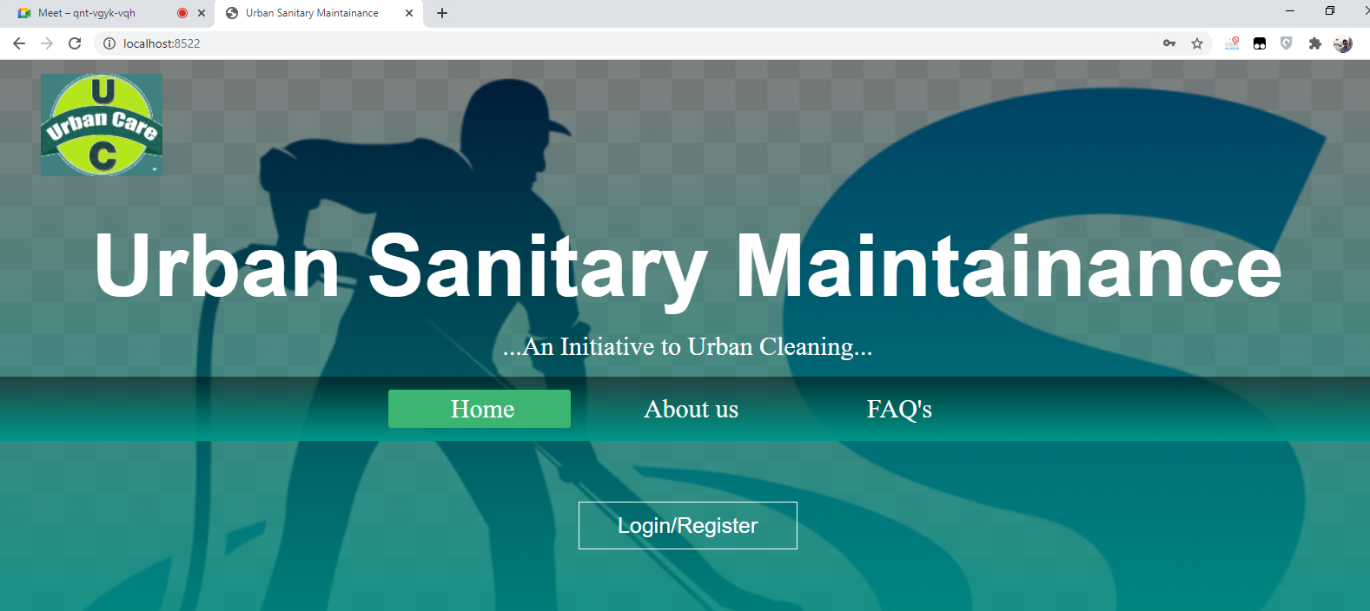
Output Screens

Slide 13
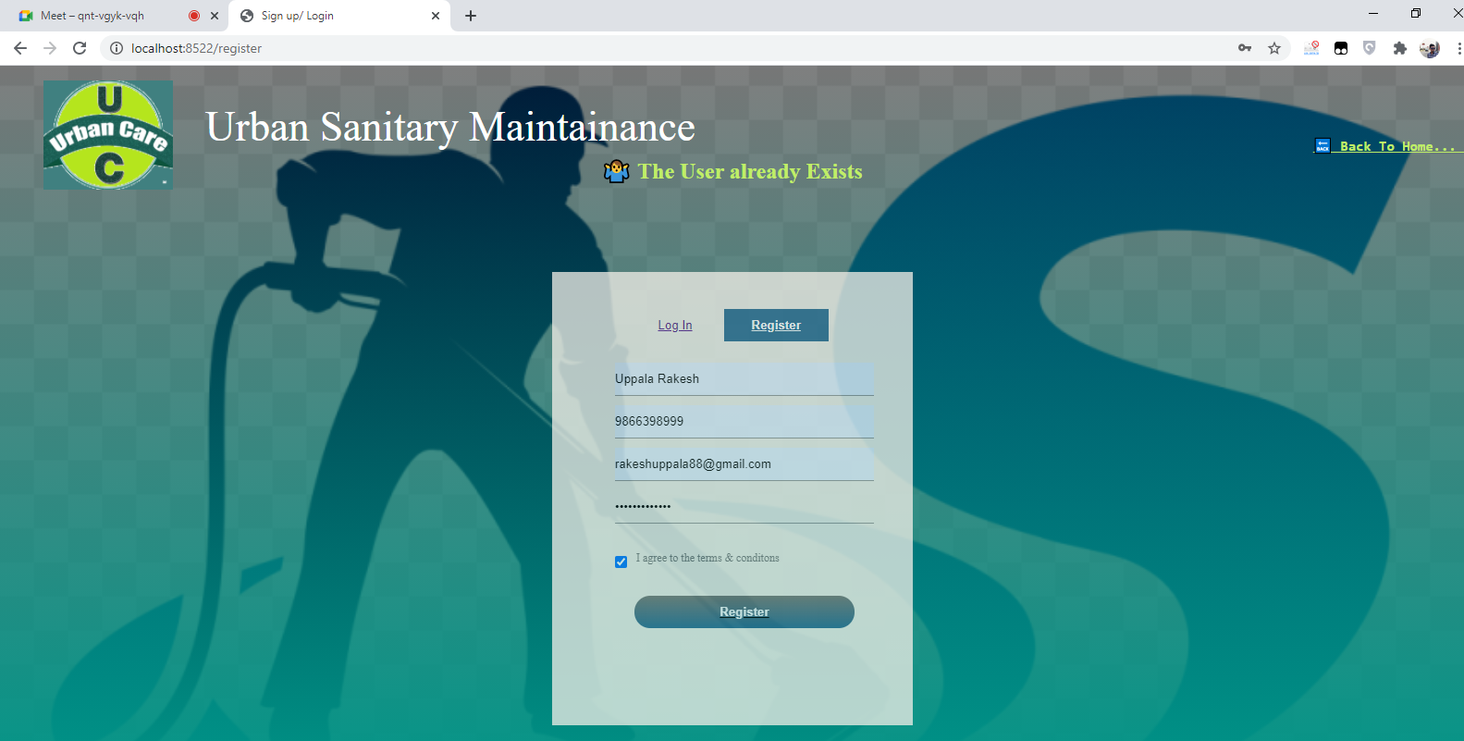
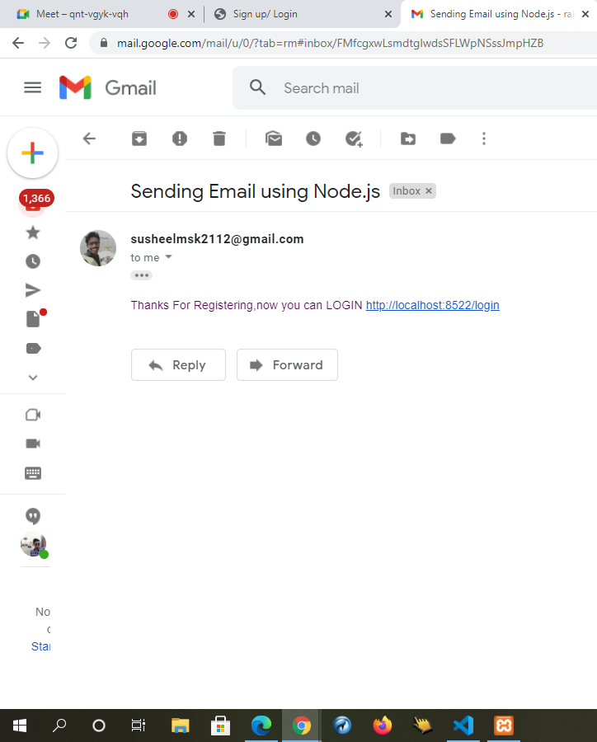
Output Screens

Slide 14
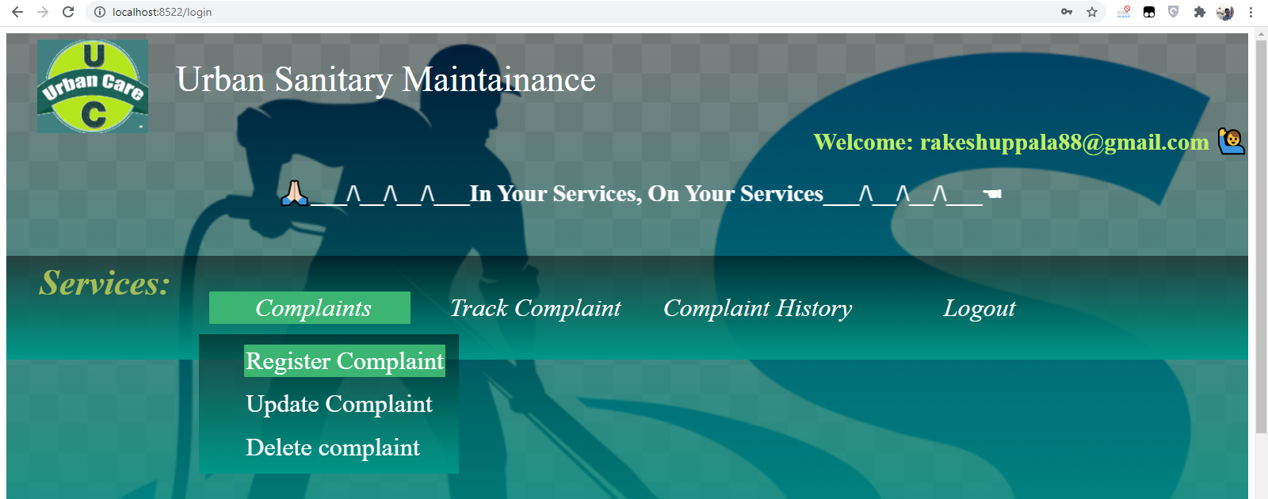
Output Screens

Slide 15
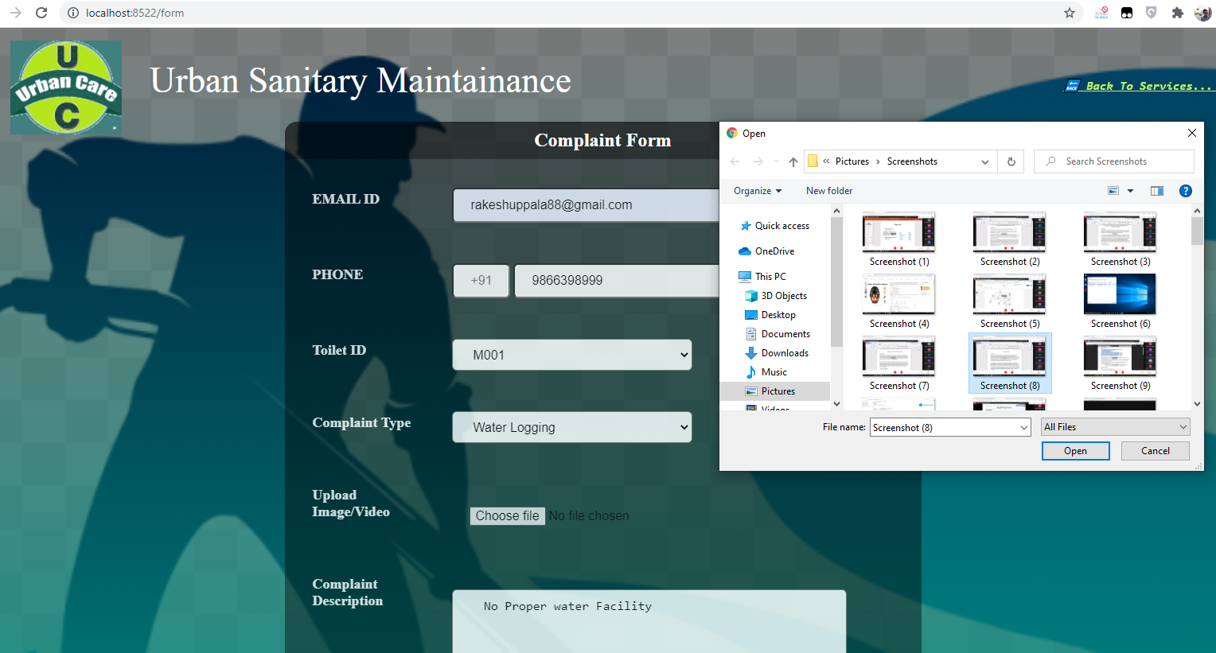
Output Screens

Slide 16
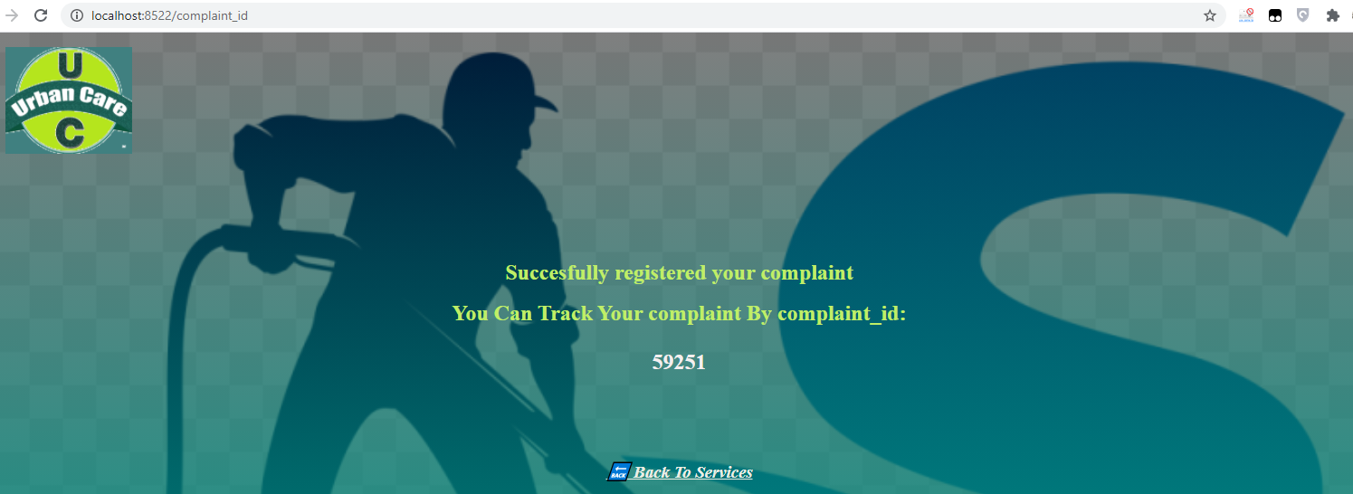
Output Screens

Slide 17
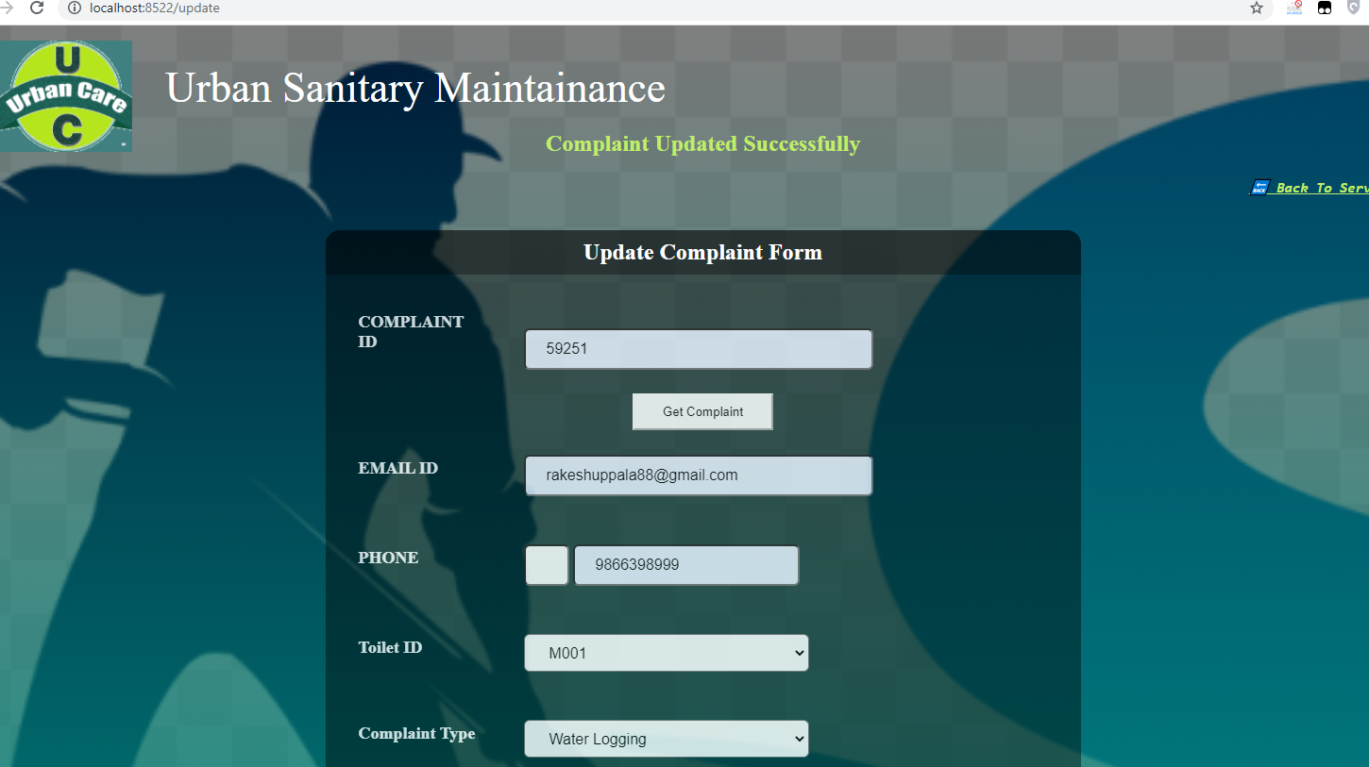
Output Screens

Slide 18
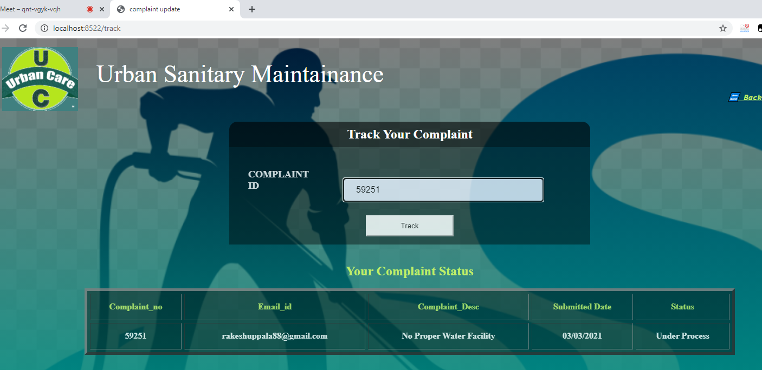
Output Screens

Slide 19
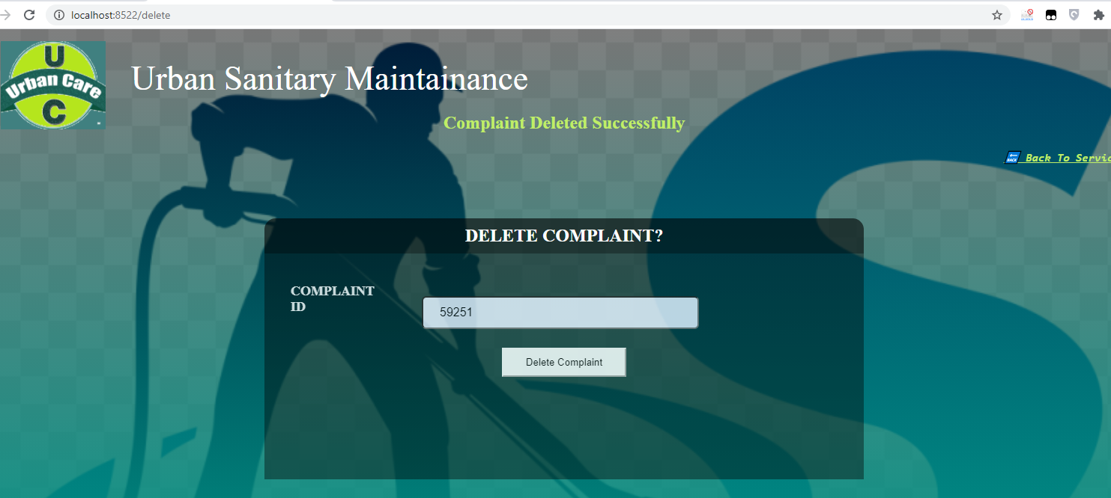
Output Screens

Slide 20
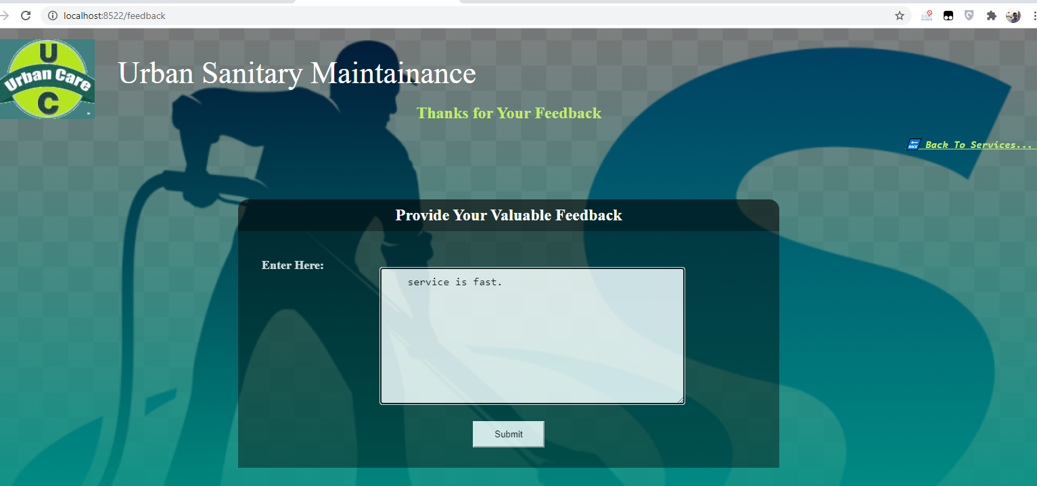
Output Screens

Slide 21
FUTURE WORK
We will include as many features as possible for the better interaction of users based on their feedbacks.
We will implement QR code System to track the address and necessary details in Metropolitan areas

Slide 22
Conclusion:
We aim to provide a better treatment for sanitization in the city through better and convenient online complaint system.

Slide 23
Thank you…

